Slide 1
DETERMINING KEY SIGNATURES
(FINDING “DO”)
Composers use key signatures to indicate to musicians where they want “do” in their music.
Key signatures have two symbols that help you determine where “do” is located.

Slide 2
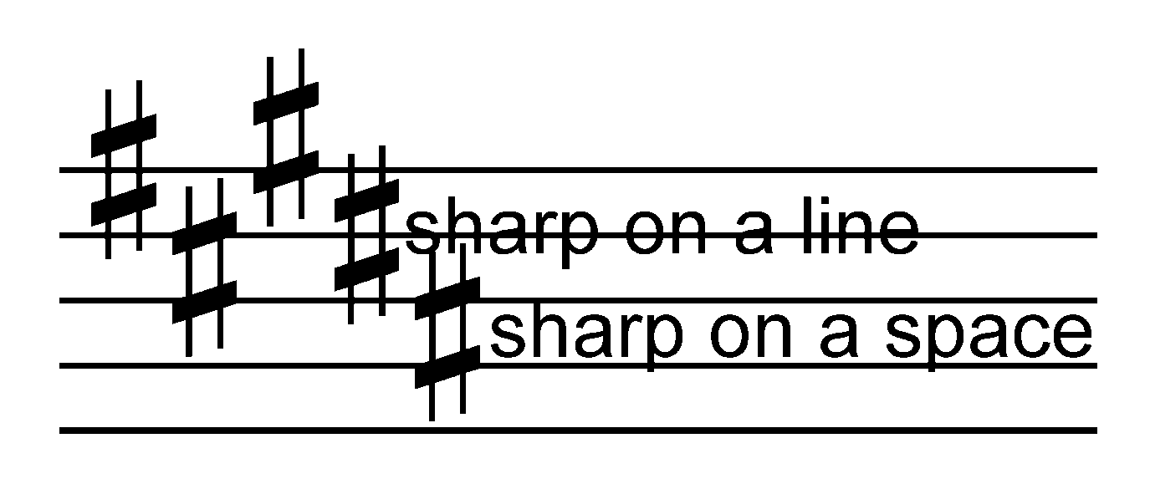
This is a sharp: ♯
When a sharp is placed on the staff you must look at the inside area of the symbol (it is shaped like a diamond) to determine if the sharp is on a line or a space.

Slide 3
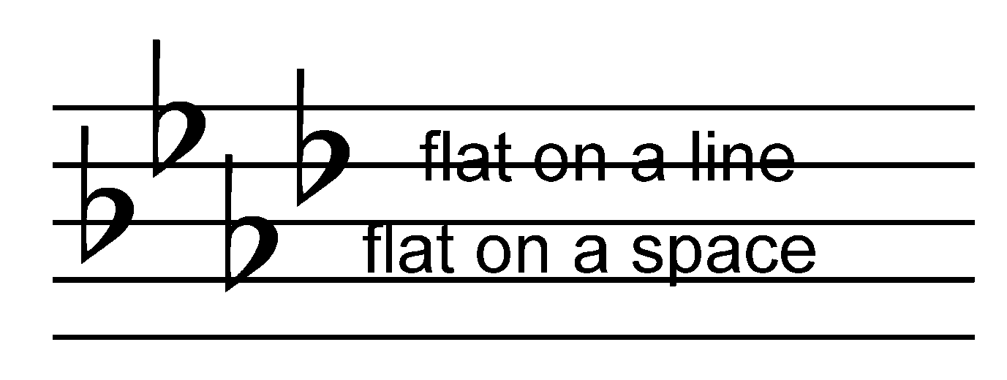
This is a flat: ♭
When a flat is placed on the staff you must look at the inside area of the symbol (it is shaped like half of a heart) to determine if the flat is on a line or a space.

Slide 4
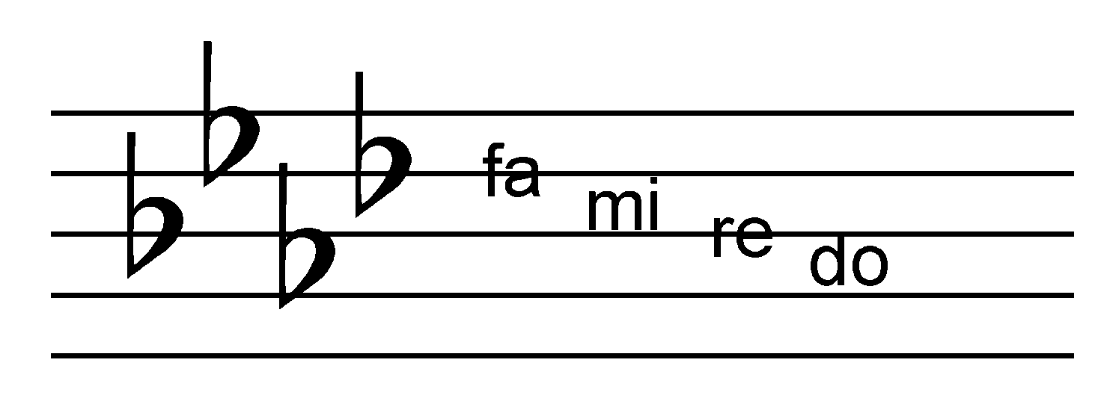
If there are flats in the key signature, the very last flat on the far right is “fa”. You can then count down the lines and spaces to find “do”.
“do” is on the 2nd space

Slide 5
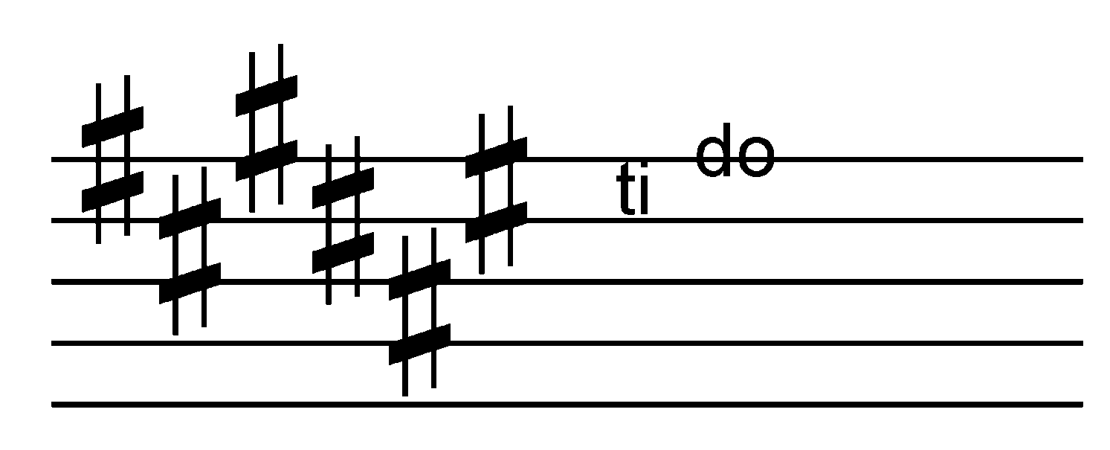
If there are sharps in the key signature, the very last sharp on the far right is “ti”. You can then move up 1 line or 1 space to find “do”.
“do” is on the 5th line

Slide 6
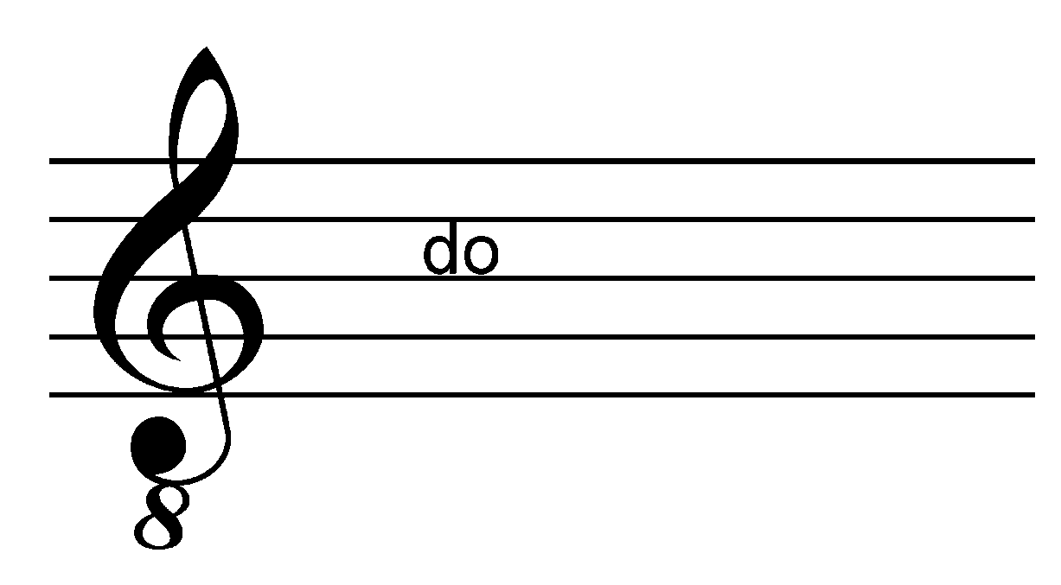
If there are no sharps or flats and you are reading bass clef, “do” is the 2nd space.
If there are no sharps or flats and you are reading treble clef, “do” is the 3rd space.

Slide 7
LINE AND SPACE LETTER NAMES
In addition to solfege syllables, the lines of the treble clef and bass clef also have letter names assigned to them.

Slide 8
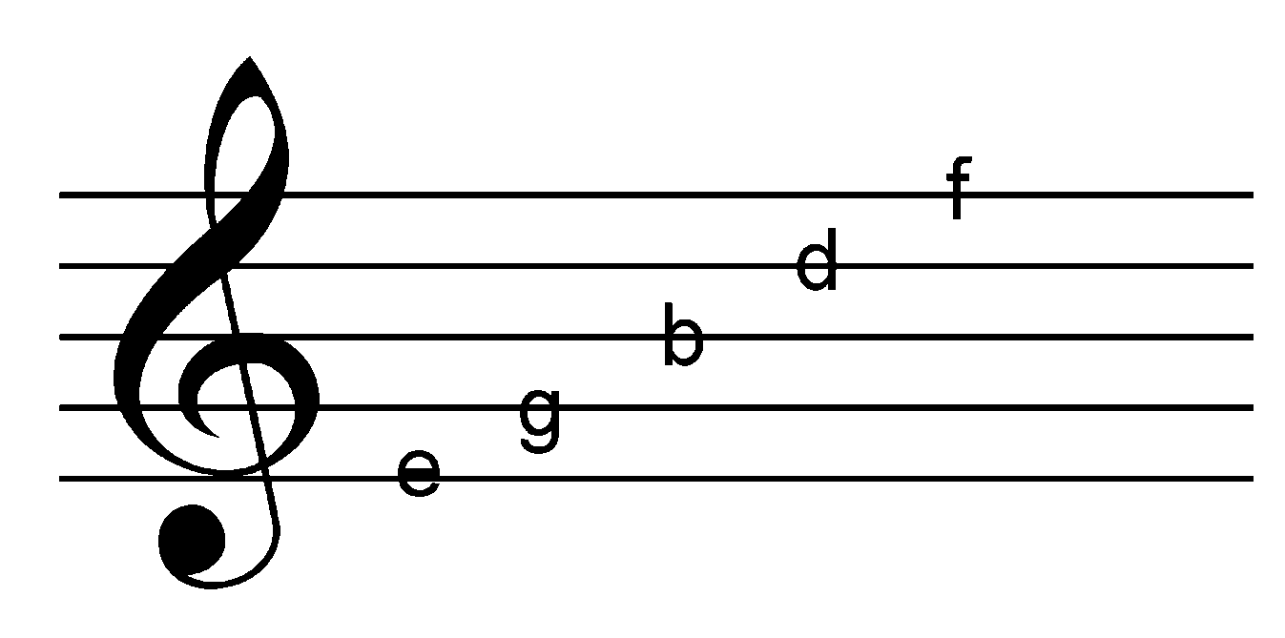
Music students often use a mnemonic to remember the lines of the treble clef. For example: Every Good Boy Does Fine.

Slide 9
To remember the lines of the bass clef try: Good Boys Deserve Fudge Always.

Slide 10
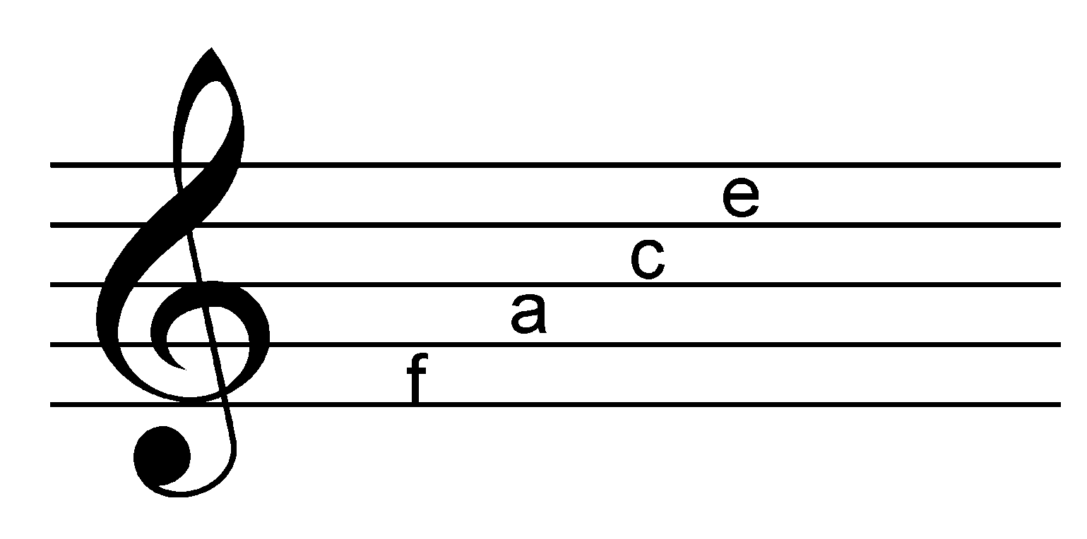
The spaces of the treble clef also have letter names. They spell “face”:

Slide 11
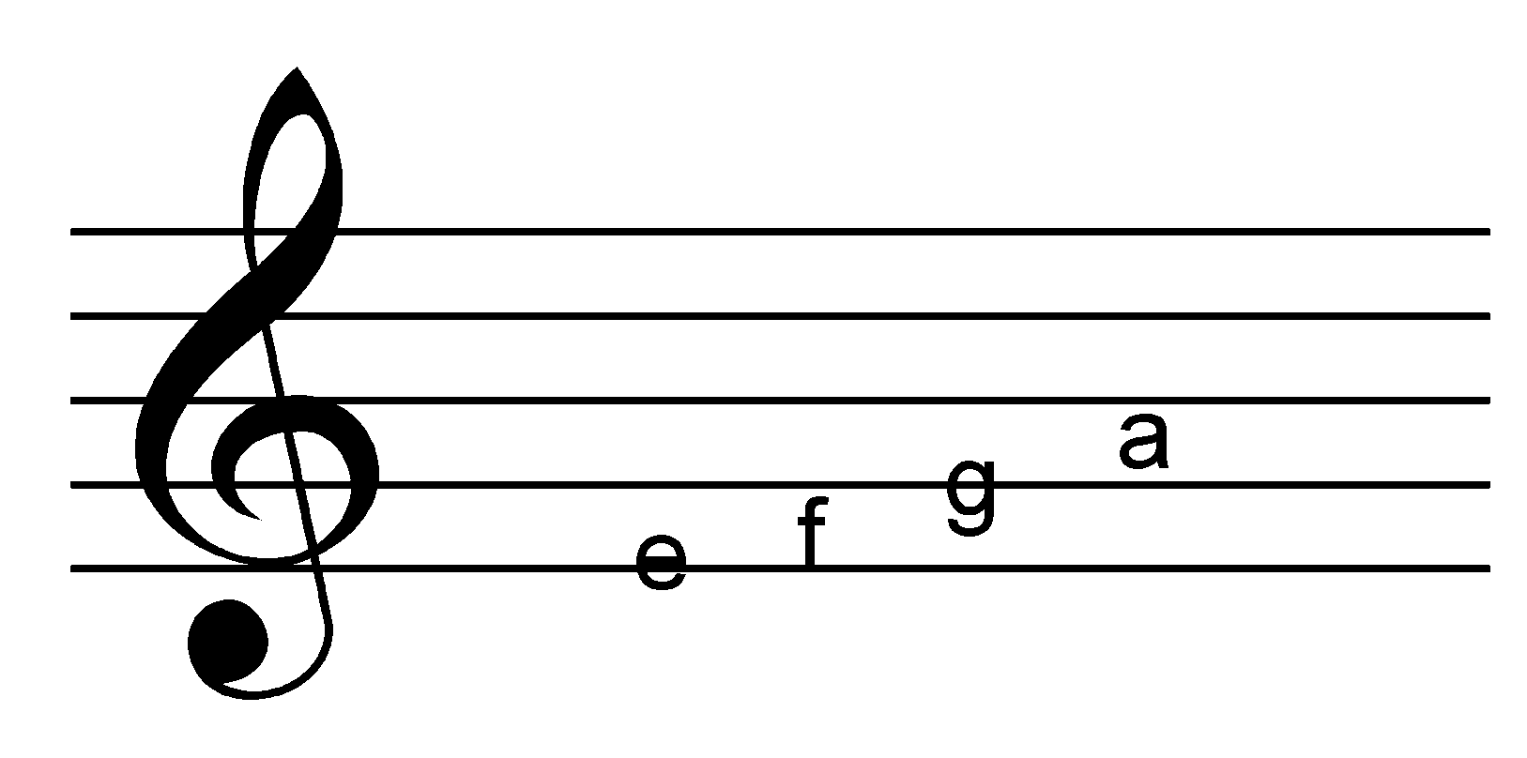
In the music, the alphabet only goes to the letter “g”. After “g” you return to the letter “a”. For example:

Slide 12
The spaces of the bass clef also have letter names. They spell “All Cars Eat Gas”:

Slide 13
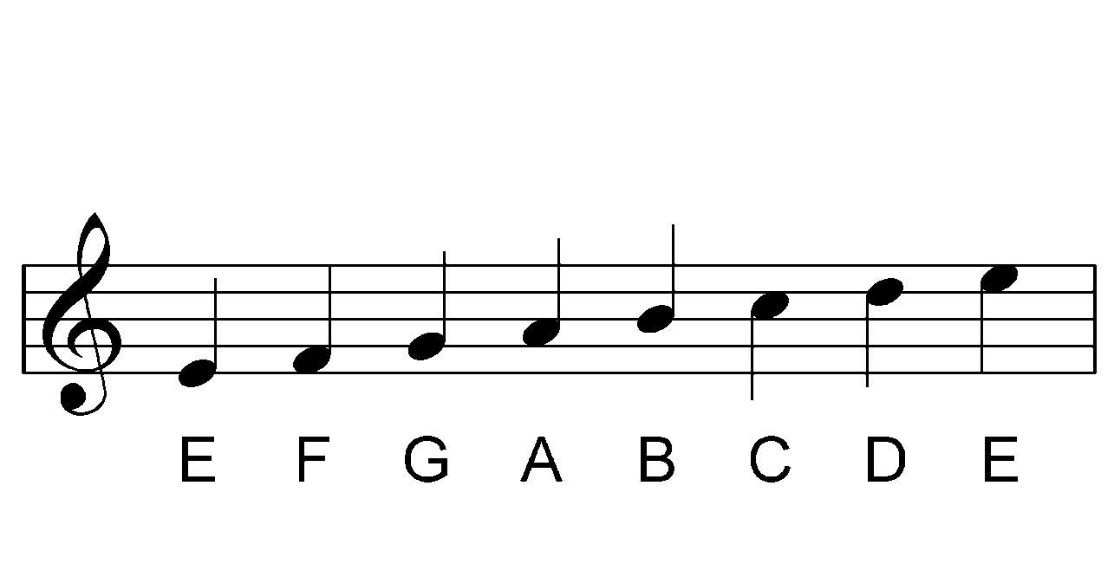
Notice that the letters move according to the music alphabet from line to space to line.

Slide 14
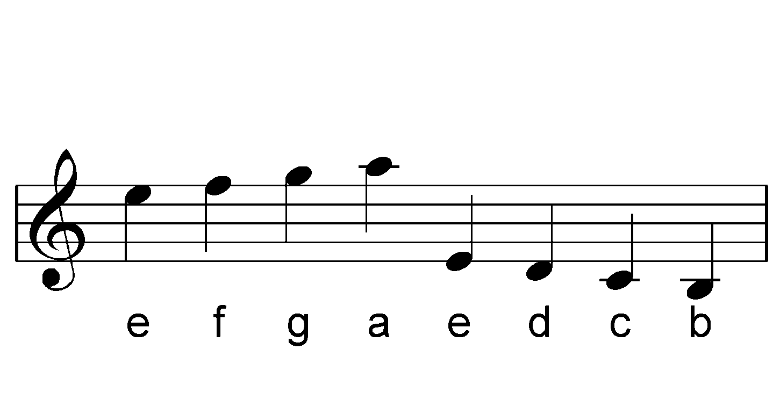
The alphabet continues to the ledger lines.

Slide 15
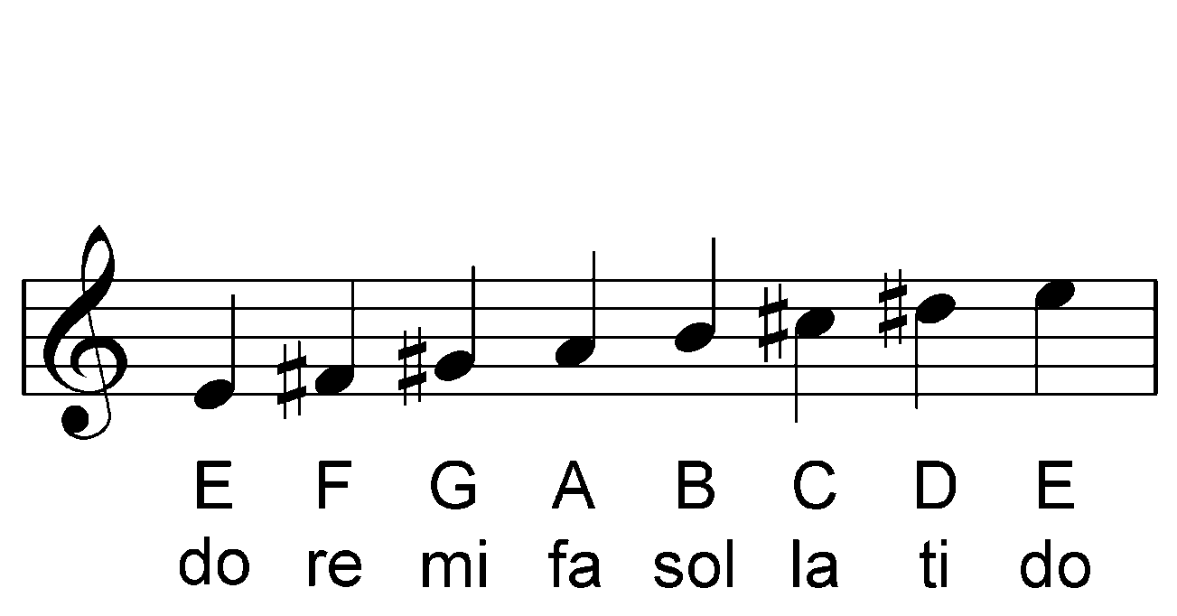
Key Signatures
Composers use key signatures to set the tonal center (the sound) of the music they are composing. If composers didn’t use an initial key signature music would become very difficult to read. For example:

Slide 16
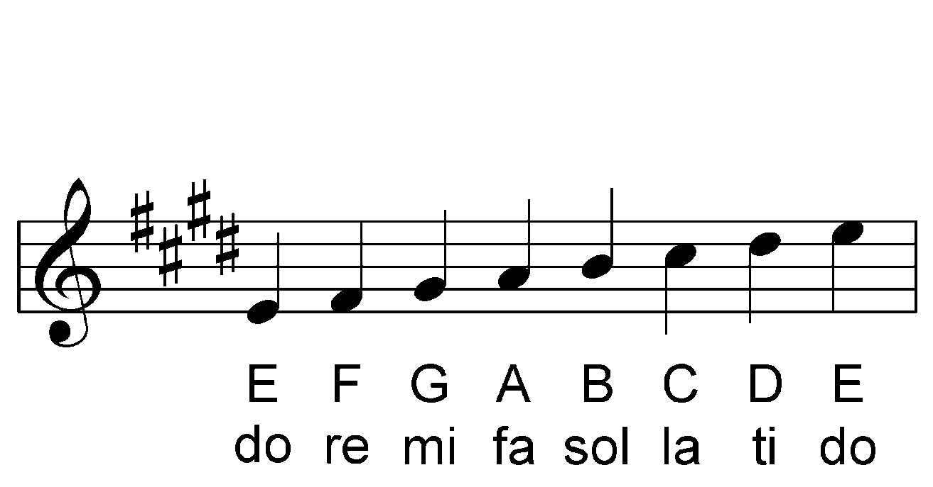
Notice the composer must put sharp symbols in front of “re, mi, la, ti” in order to maintain the whole step and half step rules of the major scale. To make music easier to read composers use an initial key signature that applies to all music that follows it.
Here is the E major scale with a key signature:

Slide 17
Once you determine where “do” is, you can determine the “key signature” or key name.
There are 2 steps to follow:
1. Determine the letter name of the line or space that “do” is on. In this example “do” is on the second space which has the letter name “A”.
2. Determine if there is a symbol on the left of “do”.

Slide 18
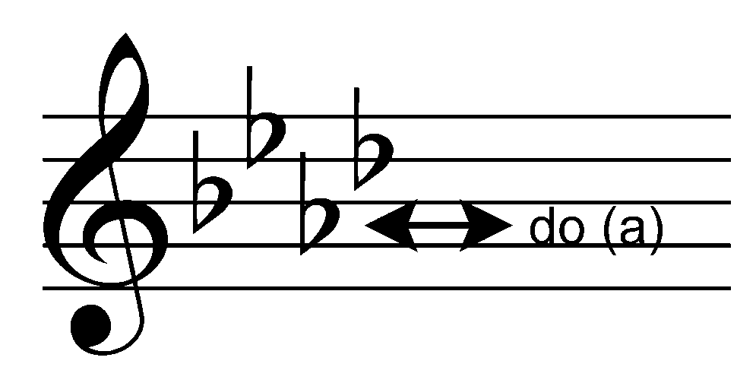
If you follow an imaginary line from “do” to the left you will notice there is a flat on the same space as “do”. Since there is a symbol there (in this case a flat), the term “flat” must be added to the key signature. In the above example, the key signature is “A Flat Major”.

Slide 19
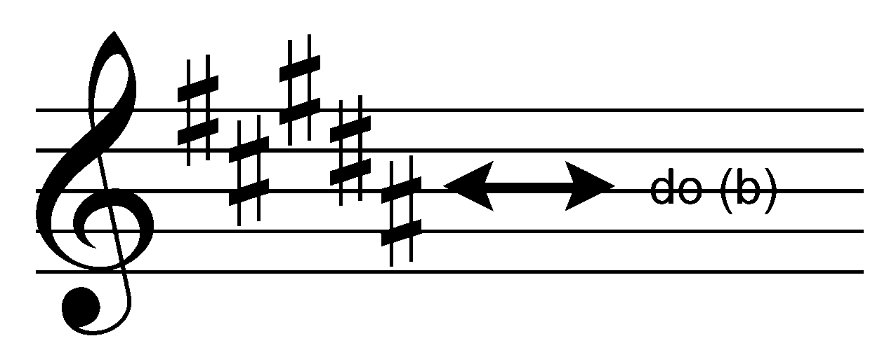
If you follow an imaginary line from “do” to the left you will notice there is no sharp on the same space as “do”. In the above example, the key signature is “B Major”.

Slide 20
All of this is important information – however you must be able to quickly recognize all key signatures. You must memorize them, as well as the order of sharps and flats.
ORDER of SHARPS = F C G D A E B (Fort Collins Girls Don’t Always Enjoy Boys)
ORDER of FLATS = B E A D G C F (It is the order of sharps backwards)
1♯ | G |  | 1♭ | F
2♯’s | D |  | 2♭’s | B♭
3♯’s | A |  | 3♭’s | E♭
4♯’s | E |  | 4♭’s | A♭
5♯’s | B |  | 5♭’s | D♭
6♯’s | F# |  | 6♭’s | G♭
7♯’s | C# |  | 7♭’s | C♭
Look!
It’s the order of ♭’s!
Look!
It’s the order of ♯’s!

